Slide 1


Acropolis Institute of Technology & Research,
Indore
TOPIC – ACROPOLIS COOPERATIVE BANK
on
BT107 – EVALUATION OF INTERNSHIP
SUBMITTED TO:-
PROF. VANDANA KATE
SUBMITTED BY:-
ANSHUL PORWAL (31)
ANUJ JAIN ( 32)
AVNISH JAIN (46)

Slide 2

INTRODUCTION
We are ACROPOLIS COOPERATIVE BANK (ACB), your one-step solution for organizing and managing all your day to day banking tasks digitally.
It is an information system especially designed for bank officials to ease their working .It mainly focuses on operations like adding new customers in the bank, deposit, withdraw, statement of the customers etc.

Slide 3
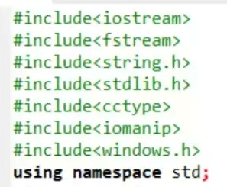
header files used
iostream
fstream
string.h
stdlib.h
cctype
iomanip
windows.h

Slide 4
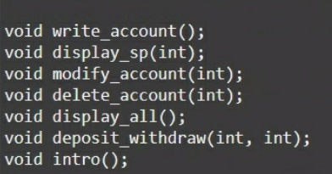
FUNCTIONALITIES
void write_account();
void display_sp(int);
void modify_account (int);
void delete_account(int);
void display_all();
void deposit withdraw(int, int);
void intro();

Slide 5
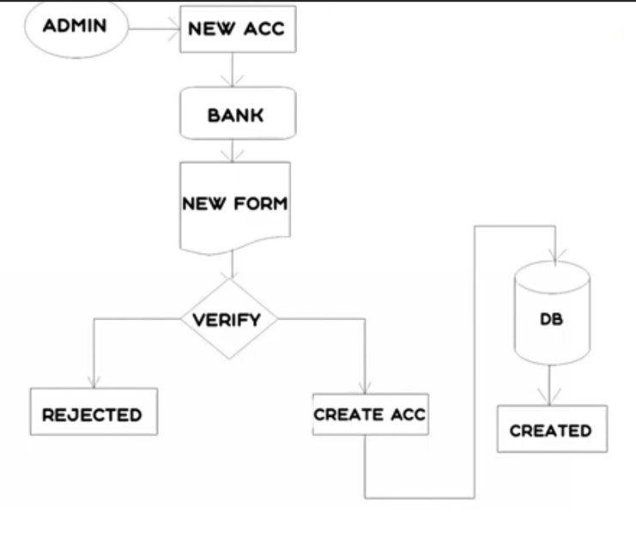
1. TO CREATE AN ACCOUNT (void write_account();)

Slide 6
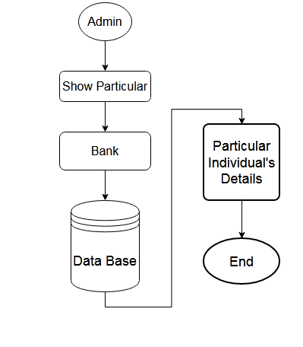
2. SHOW PARTICULAR(void display_sp(int); )

Slide 7
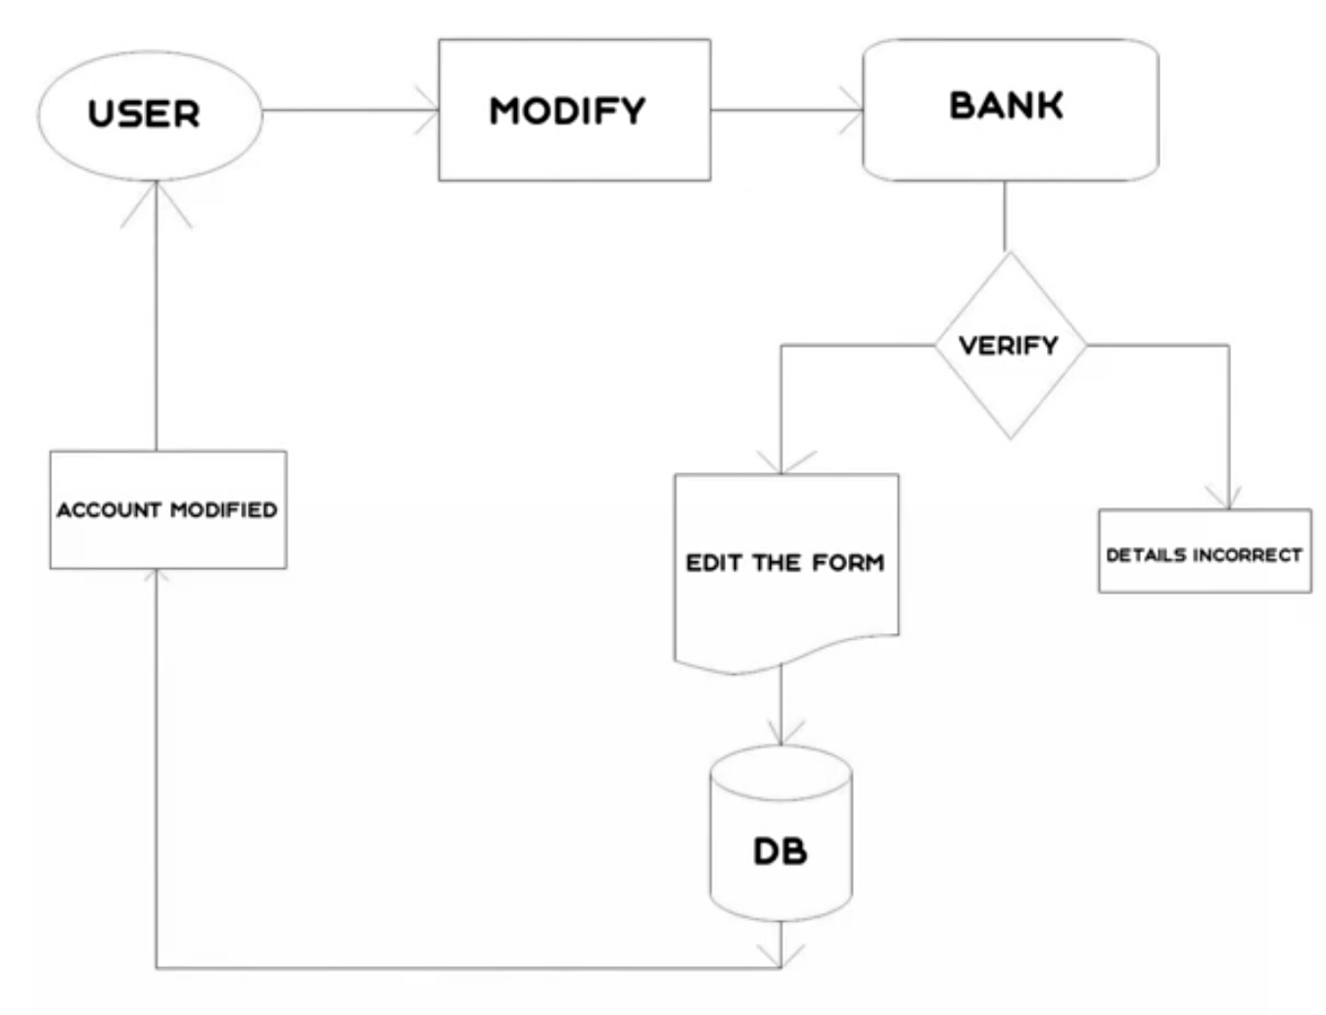
3. MODIFY DETAIL (void modify_account (int); )

Slide 8
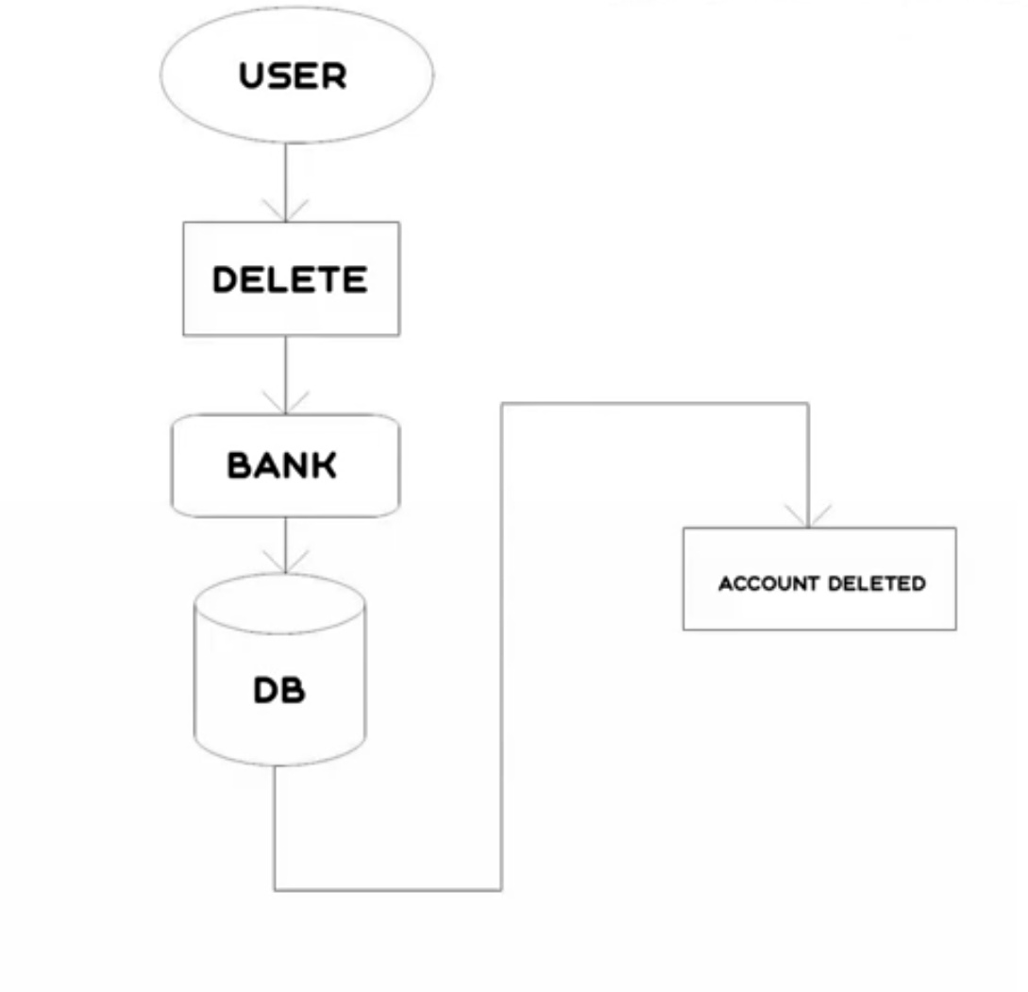
4. TO DELETE ACCOUNT (void delete_account(int); )

Slide 9
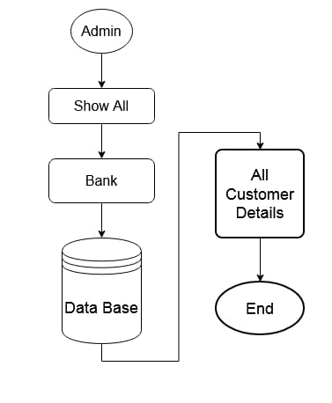
5. ALL CUSTOMER DETAILS(void display_all();)

Slide 10
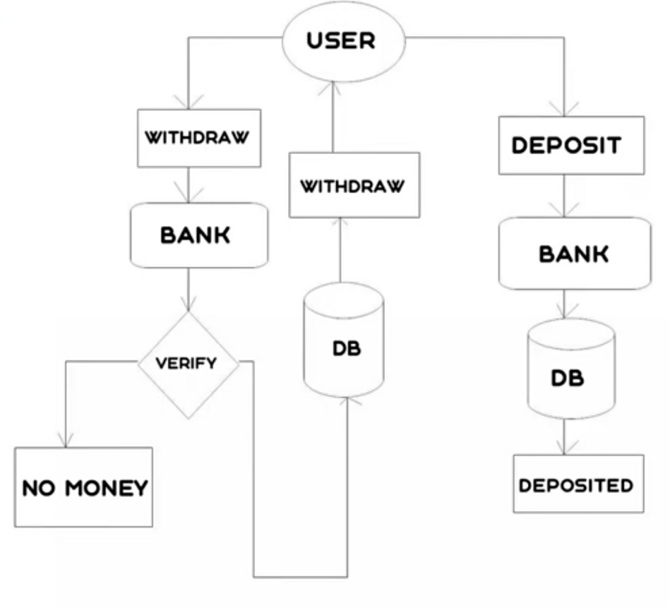
6. DEPOSIT WITHDRAW(void deposit withdraw(int, int);)

Slide 11
7. INTRODUCTION (void intro();)
Let's Move Towards Our Program

Slide 12
CONCEPT OF FILE HANDLING
1. fstream :- It is used to create files, write information to files, and read information from files.
2. ifstream :- It is used to read information from files.
3. ofstream :- It is used to create files and write information to the files.

Slide 13
CONCLUSION
This project is developed to nurture the needs of a user in a banking sector by embedding all the tasks of transactions taking place in a bank.

Slide 14


Slide 15

Raise your hand if you have any question

